Slide 1

Spotlight on Spotify
Project 1 , Group 3
John Leigh / Ianne Padagas / Shin Hae Yoon / Ana Ovalle

Slide 2
Questions & Goals
Goal: To analyze the popularity of various artists and songs using the Spotify API and Spotify’s Chart data
What makes a song popular? Are there certain characteristics that correlate with it being popular?
Are there any interesting correlations between the audio features of the most popular songs from each of our chosen artists?

Slide 3
Spotify API and Spotipy
Spotify’s web API allows us to return JSON data about artists, their albums and tracks directly from Spotify’s catalog.
SpotiPy is a Python library used in this project to make accessing the Spotify Web API more streamlined.
pip install spotipy → set up project with Spotify API → get personal ID & secret key
Allows for one time set up to access Spotify API using following code.

Slide 4
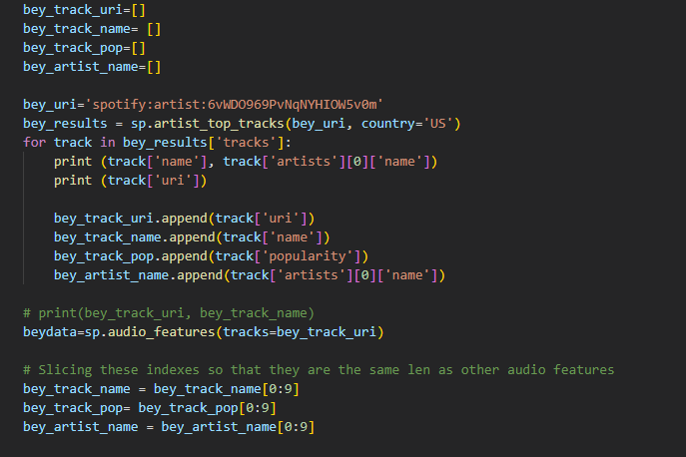
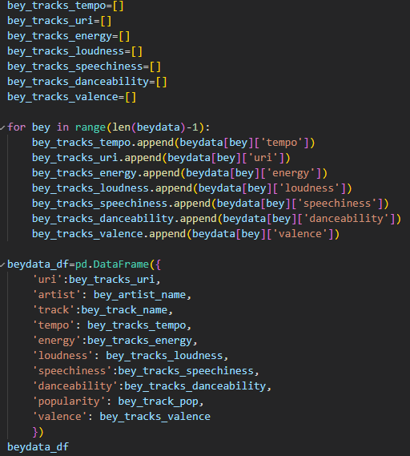
SpotiPy
Using sp. command allows us to access Spotify API endpoints (e.g. audio features)
Notes:
Top Left: Created empty lists to hold various information such as the track’s name, who the artist was, and it’s popularity score
Grabbed artist ID code from Spotify and asked API to return artists top songs in the US. Looped through each of those songs to find and store URI, track title, track popularity, and primary artist
Used stored track IDs to find each of their audio features. → (Moving to right figure) Created more empty lists for audio features of interest. Looped through audio features per track and added those audio values to the list.
Shortened/Sliced length of some lists (left figure) to match length of audio features then created Artist dataframe

Slide 5
Terms to Know
Spotify keeps track of several different audio features for every song in their catalog including: popularity, tempo, energy, loudness, speechiness, danceability and valence
URI: Unique (Uniform) Resource Indicator that you can enter in the Spotify Desktop client’s search box to locate an artist, album, or track.
Popularity: Measure of a track’s popularity on a scale of 0-100, where 100 is most popular. Calculated based on total number of plays and how recent those plays are.
Tempo: An estimate of the track’s beats per minute
Energy: A value between 0.0-1.0 that measures the intensity and activity of the track
Loudness: The calculated loudness of track in decibels. The value is an average of the loudness over the entire track.
Speechiness: A measure of the presence of spoken words in a track ranging from 0.0-1.0. The closer a track is to 1.0, the more the track is exclusively speech.
Danceability: A measure of how suitable a track is for dancing based on various song elements. The scale is from 0.0-1.0
Valence: A measure from 0.0 to 1.0 describing the musical positiveness conveyed by a track. Tracks with high valence sound more positive (e.g. happy, cheerful, euphoric), while tracks with low valence sound more negative (e.g. sad, depressed, angry).
Notes:
Speechiness: Tracks between 0.33-0.66 tend to contain both music and speech such as rap songs. Whereas values below 0.33 most likely represent music and more instrumental songs.

Slide 6
Scope
Using Spotify’s web API as well as the SpotiPy library, we analyzed the top ranked songs from several different artists including:
Beyonce
SZA
Bad Bunny
Adele
Morgan Wallen

Slide 7
Process Steps
Pull the song data from Spotify API using SpotiPy library
Wrangle each artists’ data into a dataframe (beydata_df, szadata_df, etc…)
Merge these dataframes to get a master dataframe containing all of the song data
Order the master dataframe based on the ‘popularity’ score for each song
Create scatter plots for the master dataframe to get an idea of the “meta” trends
Break the master dataframe into tiers based on popularity rank and perform the same analysis
We broke the dataframe up into 4 roughly equal tiers using the following scores:
Top Tier: ‘popularity’ >= 86
Second Tier: 80 <= ‘popularity’ < 86
Third Tier: 75 <= ‘popularity’ < 80
Bottom Tier: 0 <= ‘popularity’ < 75
Bottom Tier
Third Tier
Second Tier
Top Tier
0
75
80
85
100

Slide 8
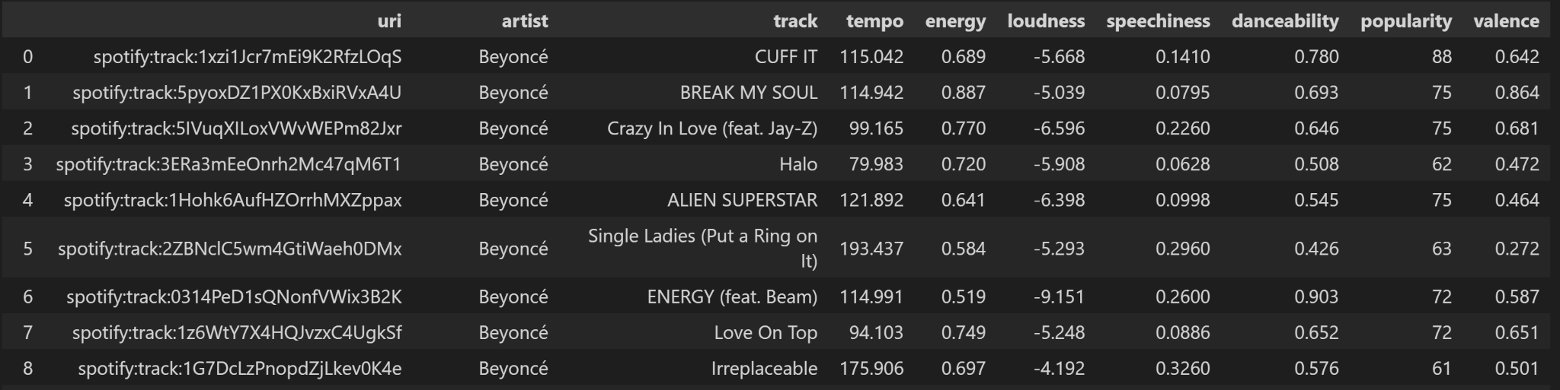
Beyonce Data

Slide 9
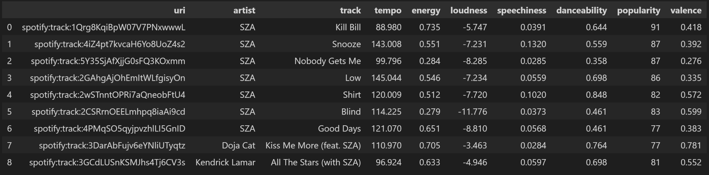
SZA Data

Slide 10
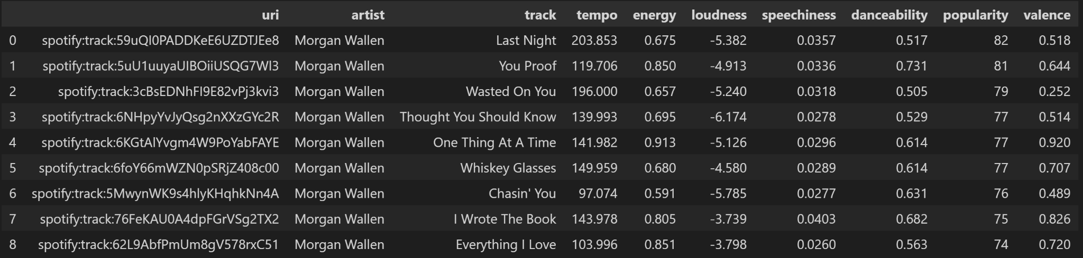
Morgan Wallen Data

Slide 11
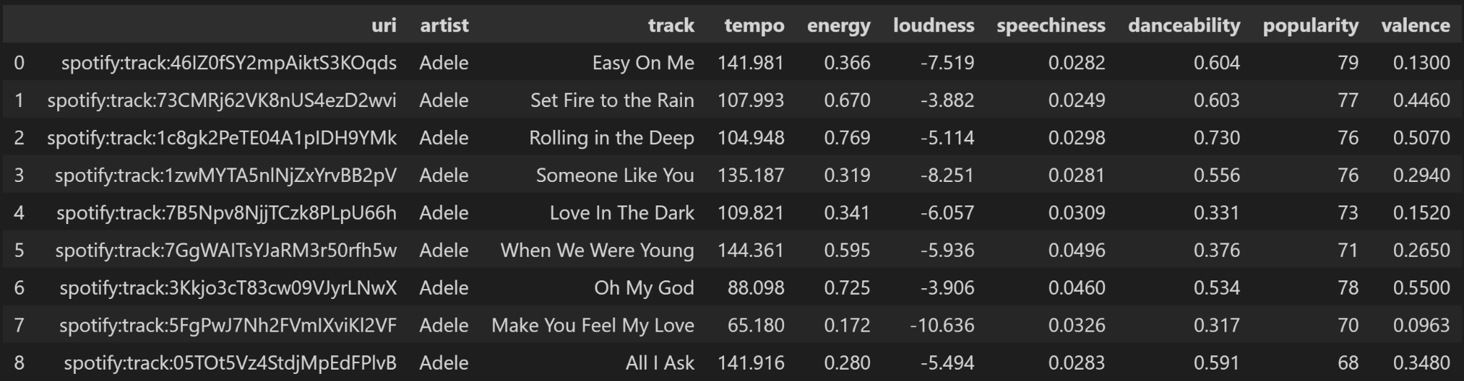
Adele Data

Slide 12
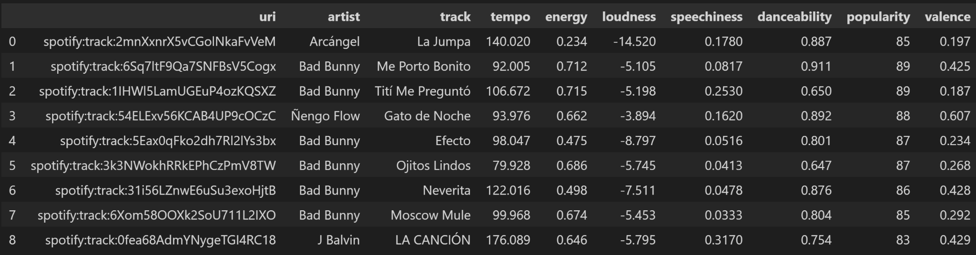
Bad Bunny Data

Slide 13
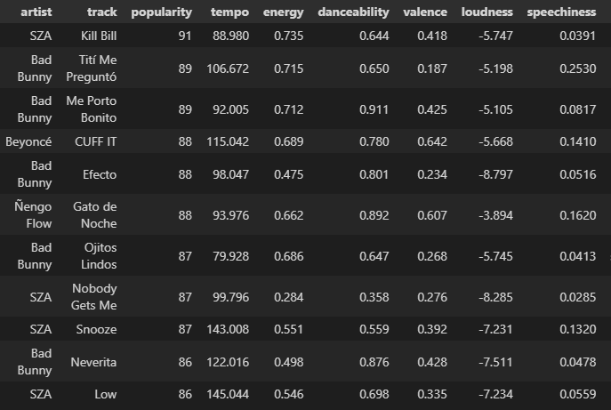
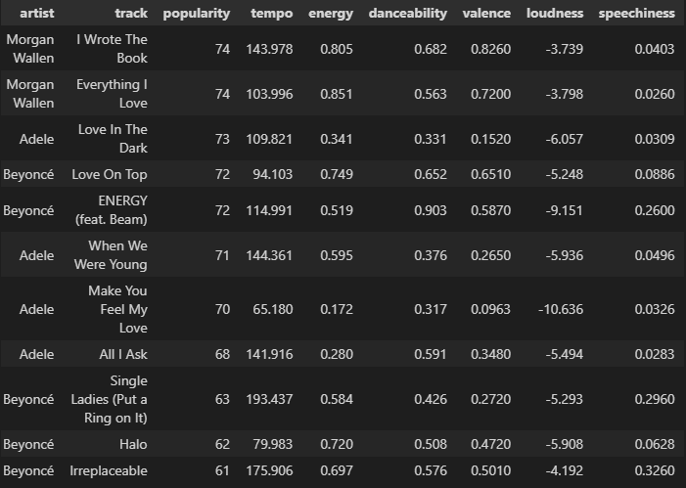
Defining Our Tiers
Separated songs based on a cutoff point by Spotify’s popularity value:
Top Tier >=86, Second Tier 86>x>=80
Third Tier 80>x>=75, Bottom Tier <75
Notes:
Left is Top-Tier Songs, Right is Bottom-Tier. As mentioned earlier, Spotify defines popularity based on total # of plays and recency of those plays.

Slide 14
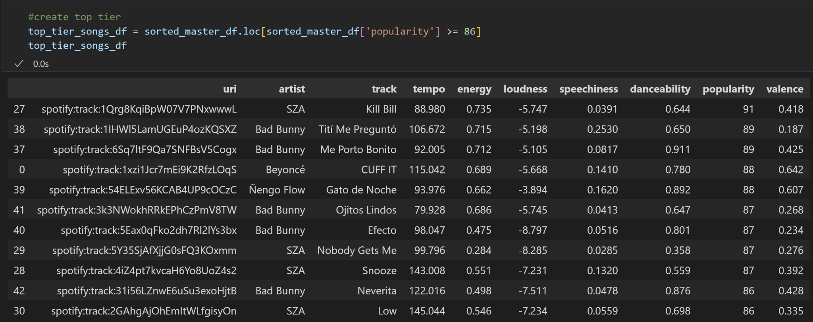
Top Tier Songs

Slide 15
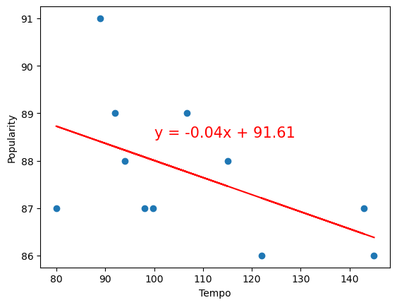
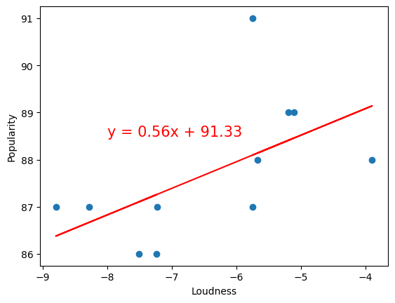
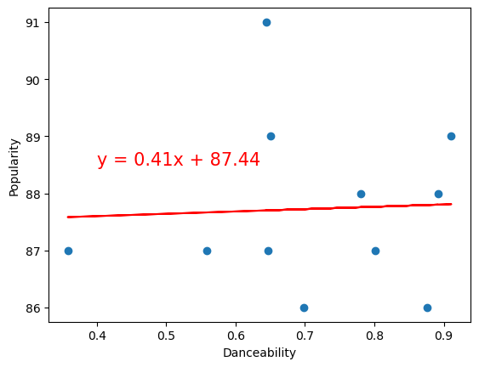
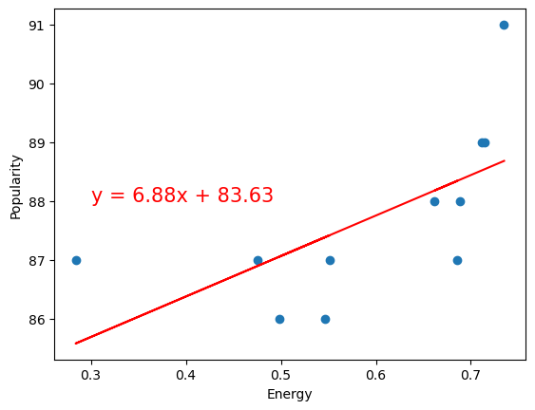
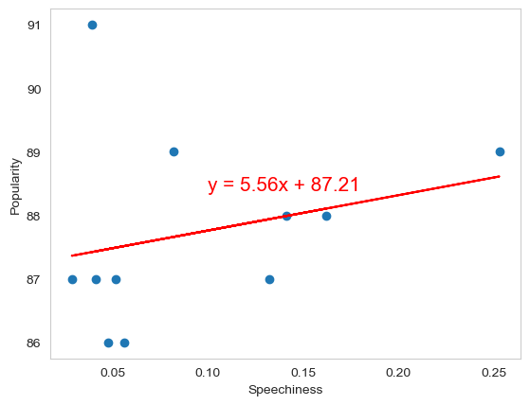
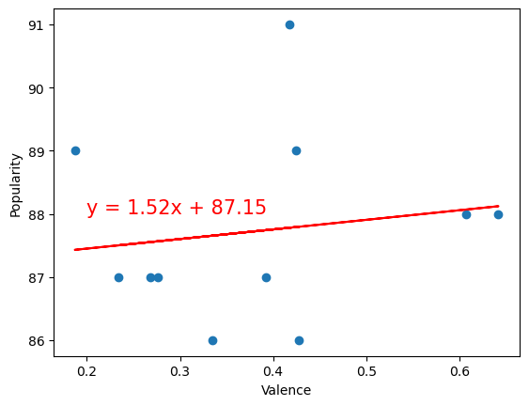
Top Tier Analysis
r-value = 0.643
r-value = 0.643
r-value = -0.519
r-value = 0.570
r-value = 0.045
r-value = 0.643
r-value = 0.262
r-value = 0.148
Notes:
Songs higher in popularity in the top tier tend to be lower in tempo
There is almost no correlation between danceability and popularity in the top tier

Slide 16
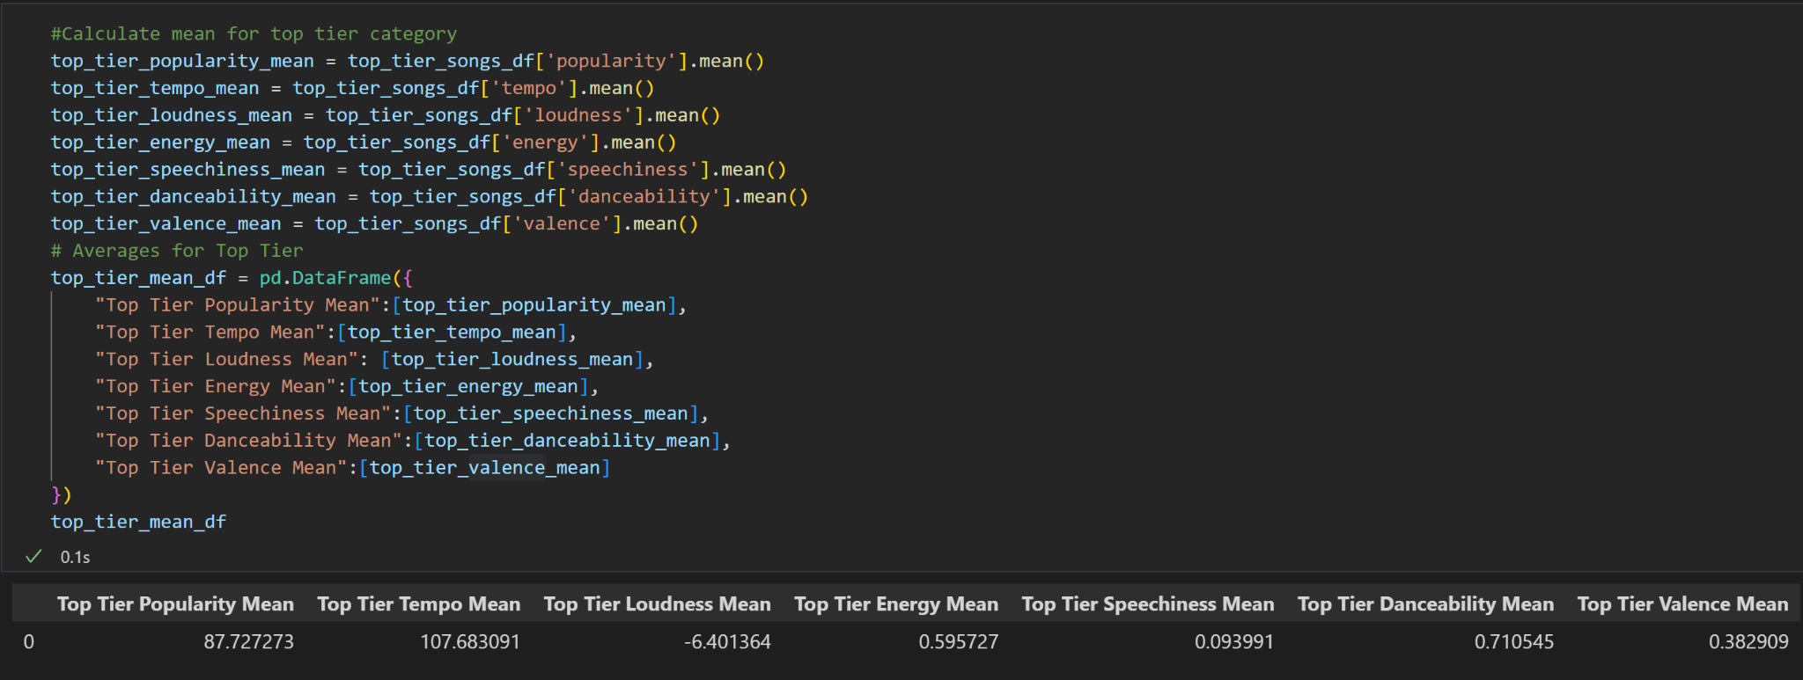
Top Tier Songs - Track Attribute Means
Notes:
We calculated the mean values of the songs from each tier

Slide 17
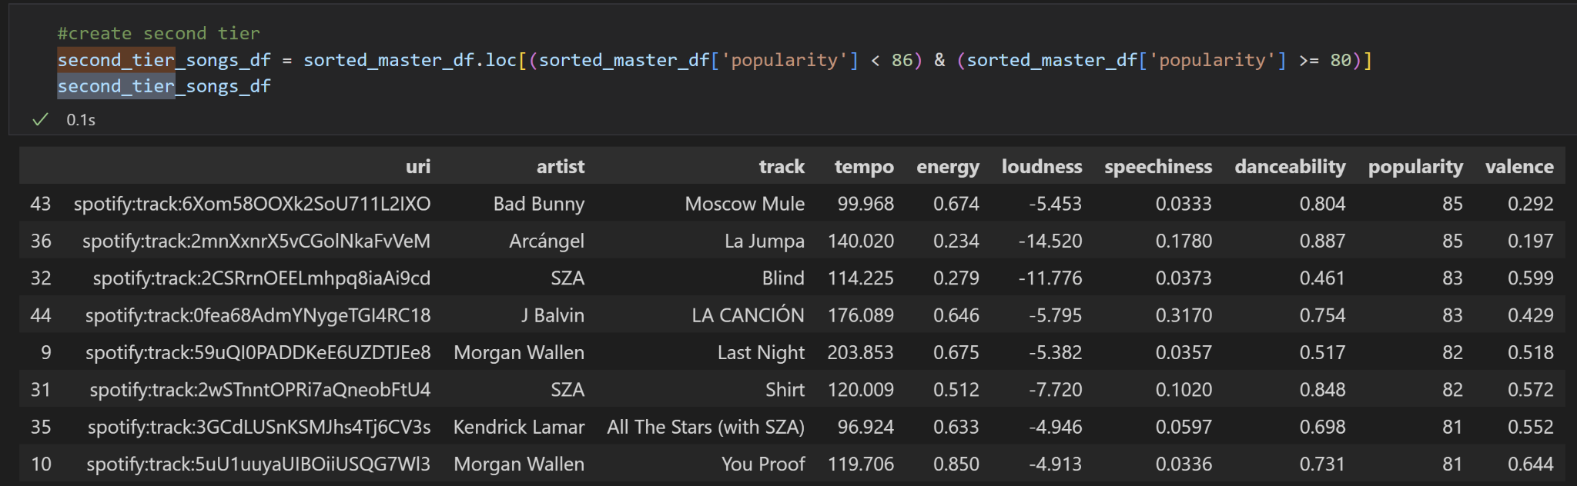
Second Tier Songs

Slide 18
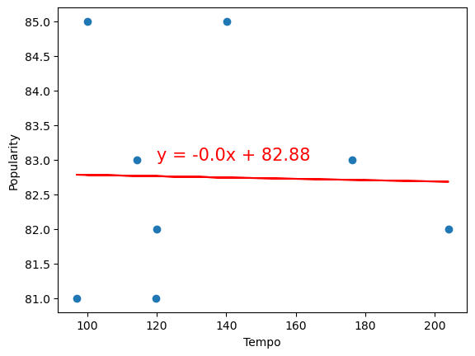
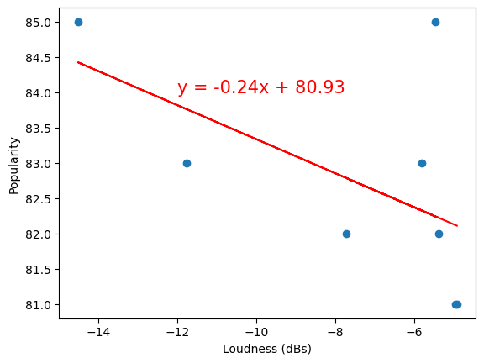
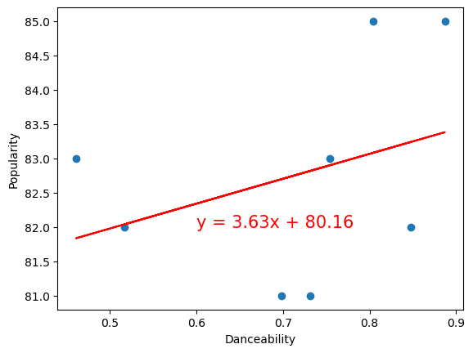
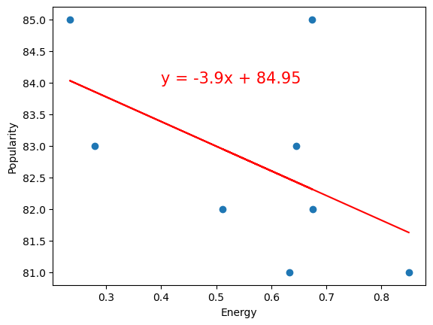
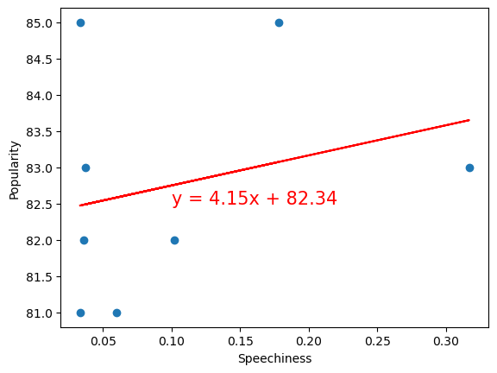
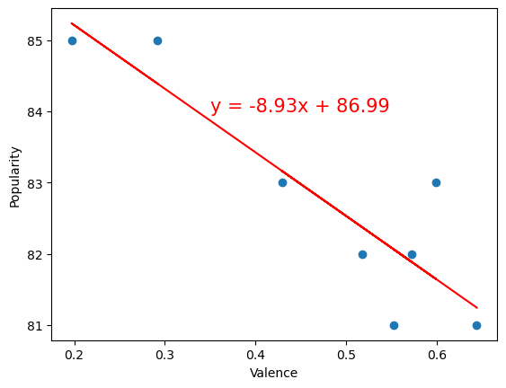
Second Tier Analysis
r-value: -0.022
r-value: -0.553
r-value: 0.347
r-value: -0.519
r-value: 0.265
r-value: -0.890
Notes:
Things to note: Some fairly strong negative correlations in our second tier of songs in energy, loudness, and especially valence. So as the songs had more energy and more happiness, they tended to be less popular.
No real relationship between popularity and tempo in this tier. But there is a slight positive correlation between danceability and popularity in this tier

Slide 19
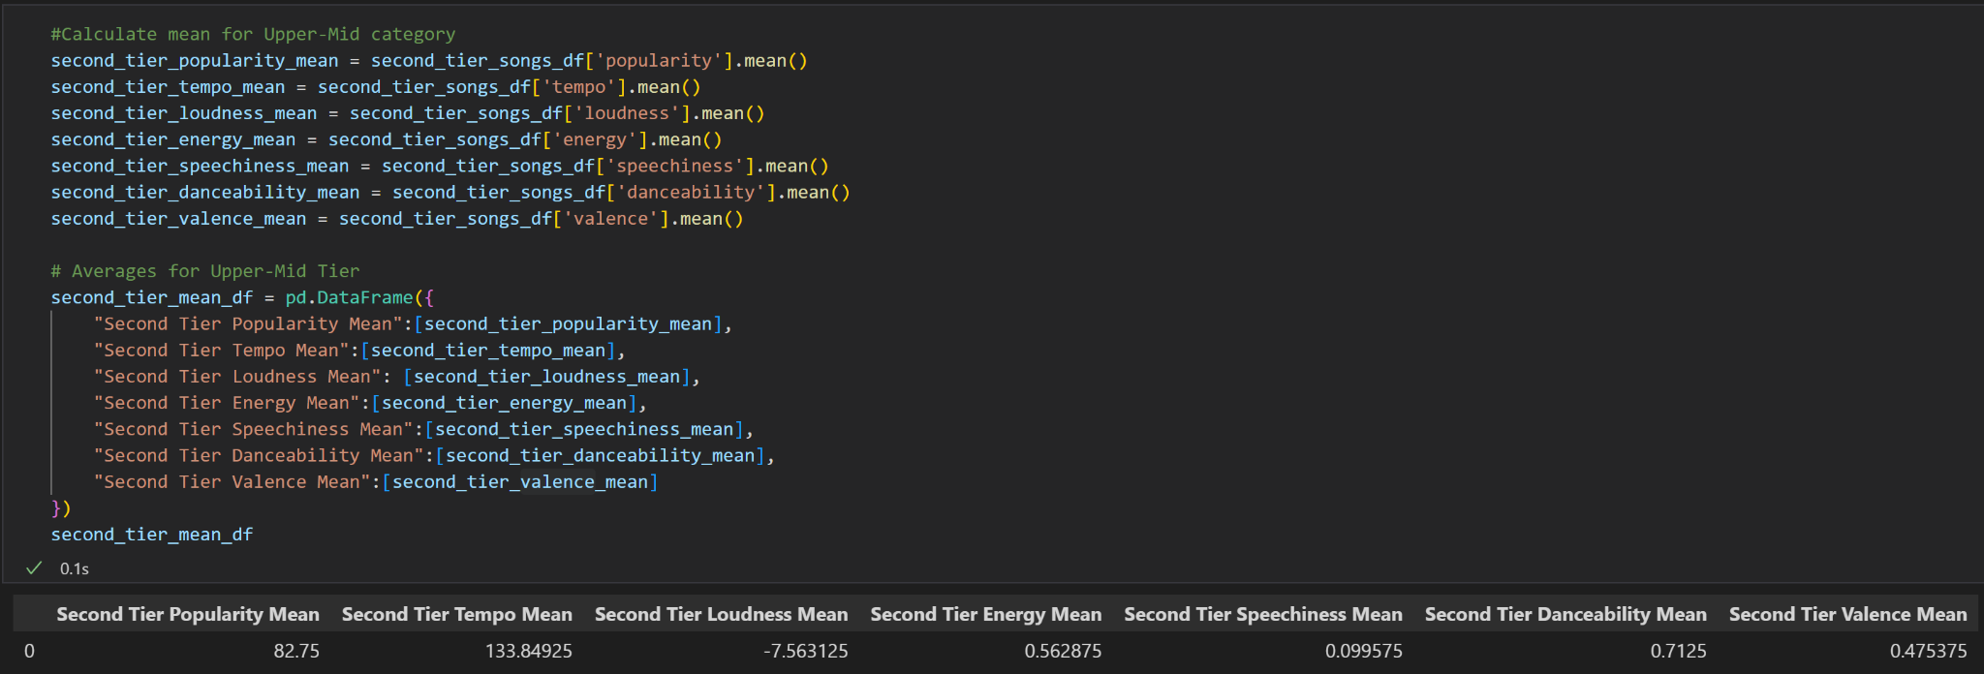
Second Tier Songs - Track Attribute Means

Slide 20
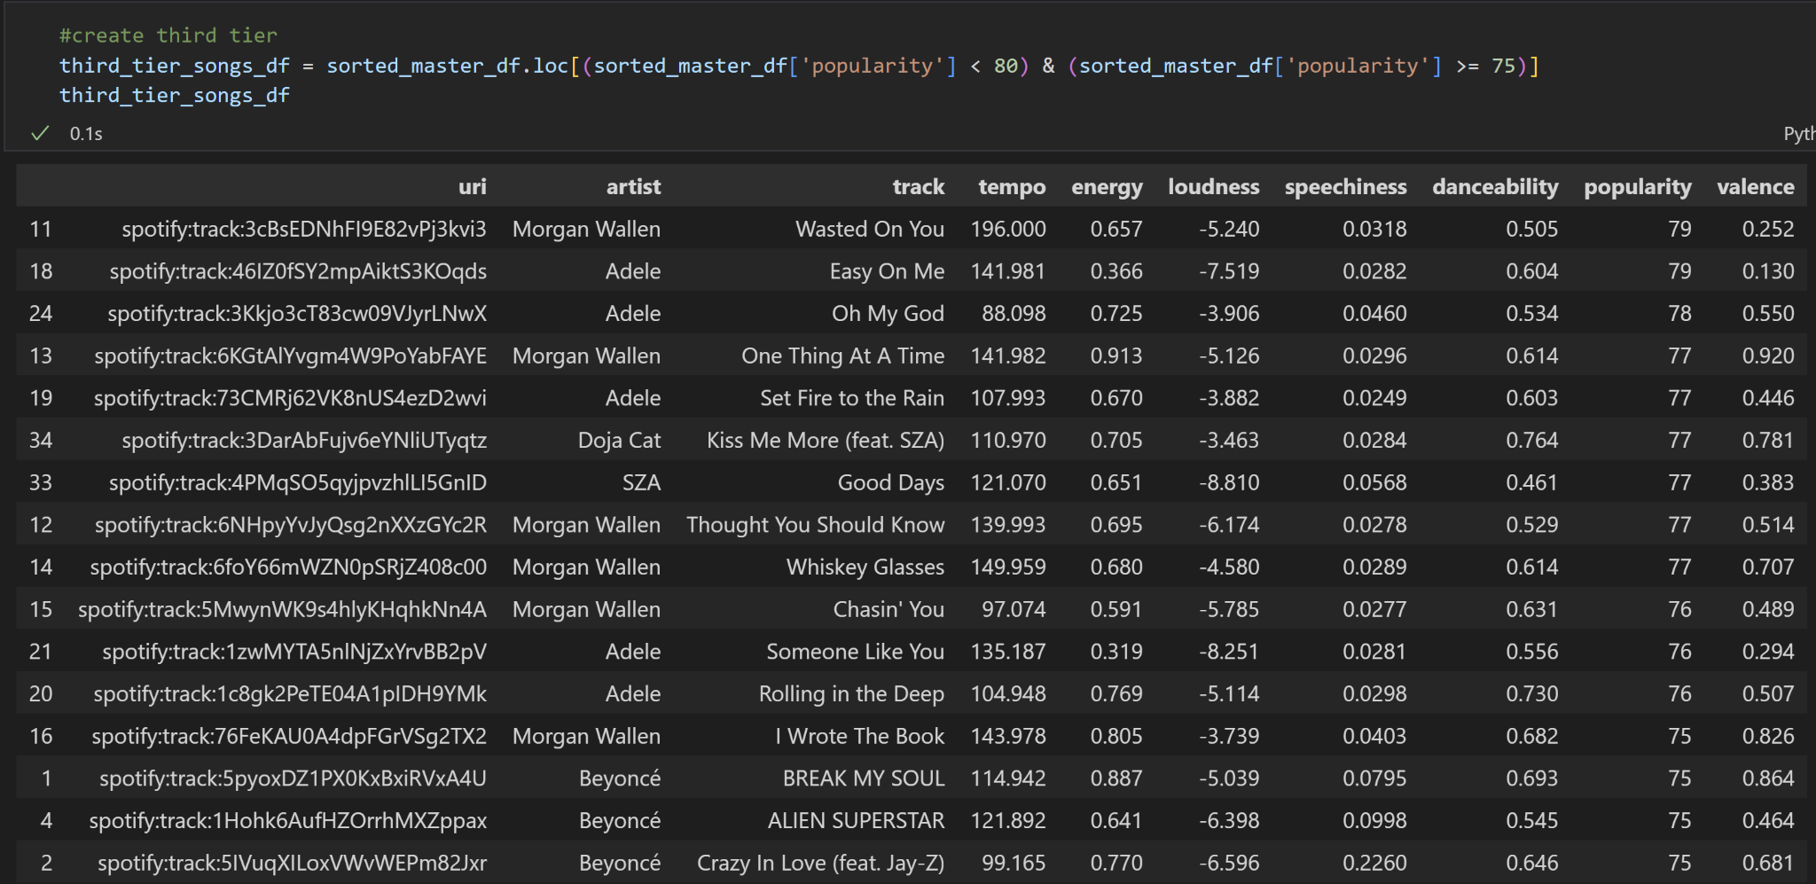
Third Tier Songs

Slide 21
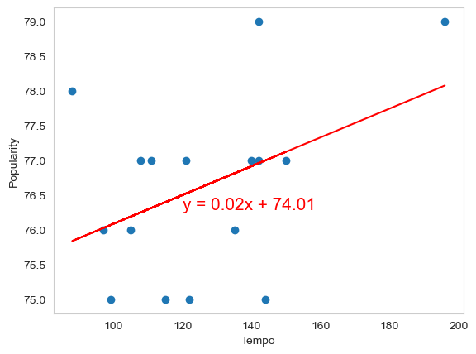
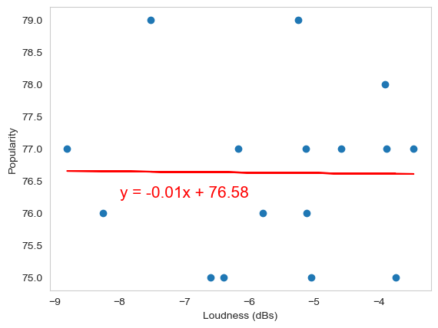
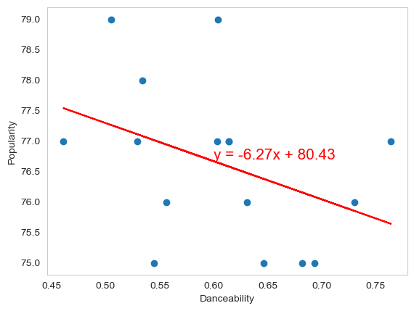
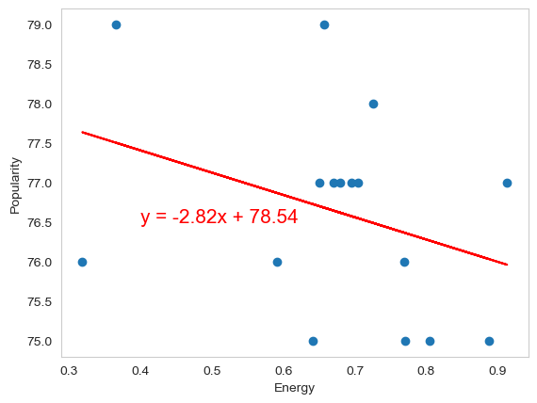
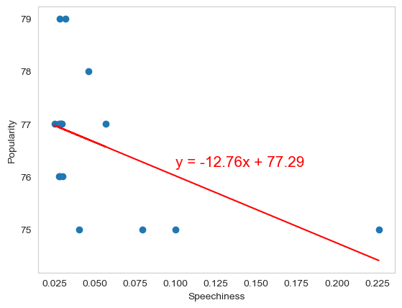
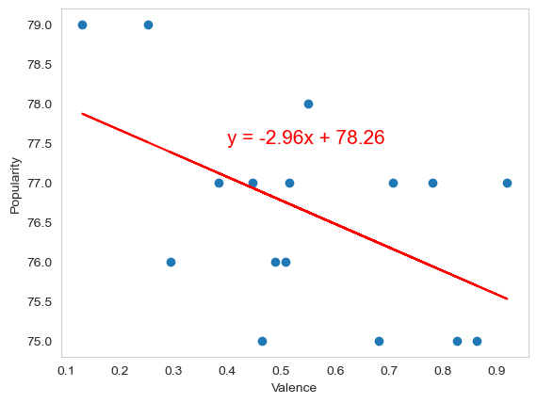
Third Tier Analysis
r-value = 0.423
r-value = -0.011
r-value = -0.399
r-value = -0.339
r-value = -0.497
r-value = -0.519
Notes:
Lots of negative correlations between popularity and other features. Only tempo and popularity have a positive relationship in this tier unlike in previous tiers.

Slide 22
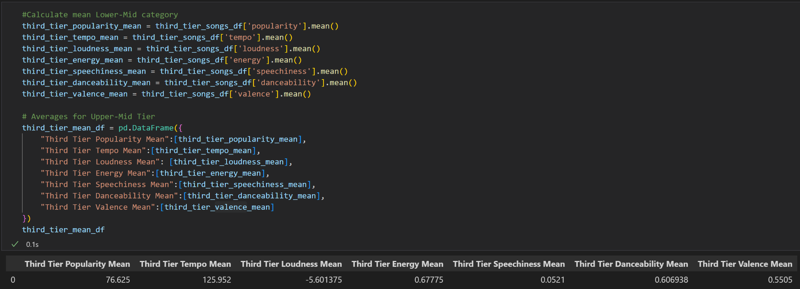
Third Tier Songs - Track Attribute Means

Slide 23
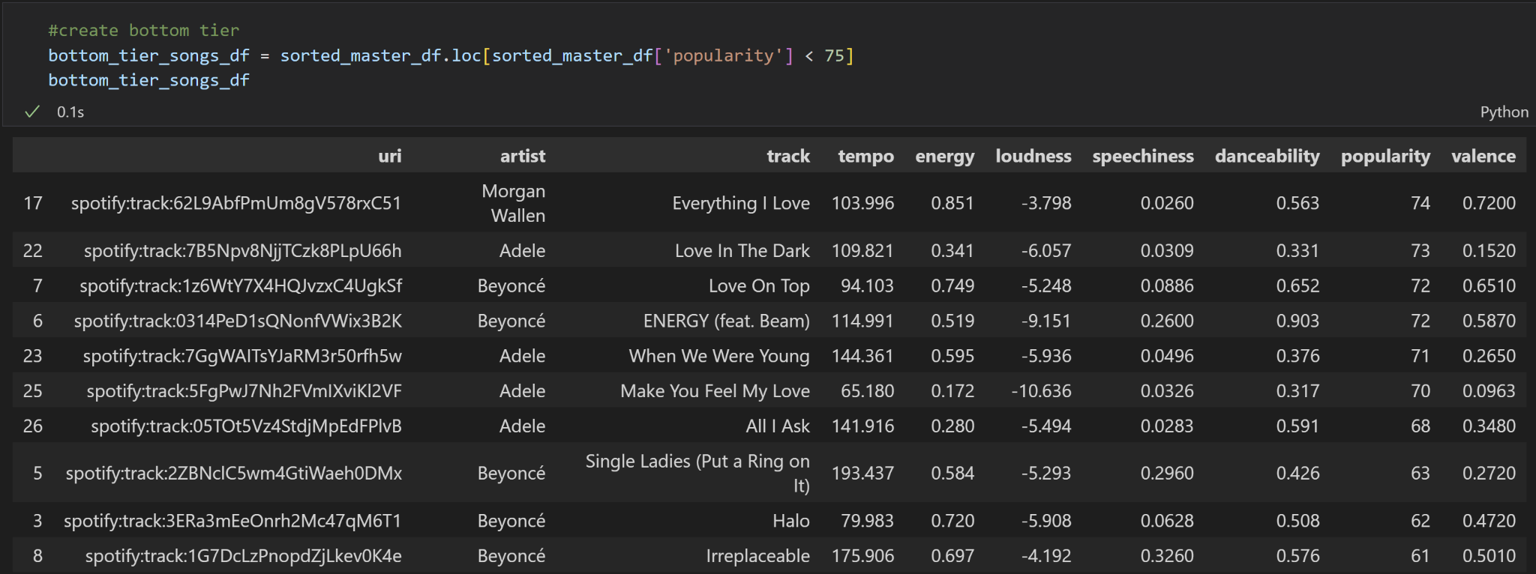
Bottom Tier Songs

Slide 24
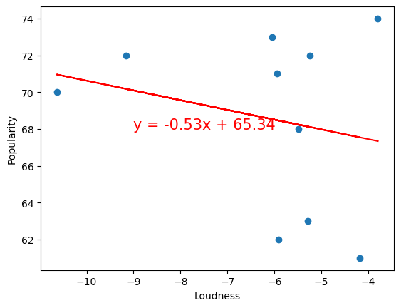
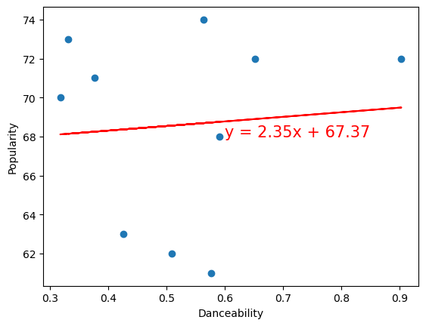
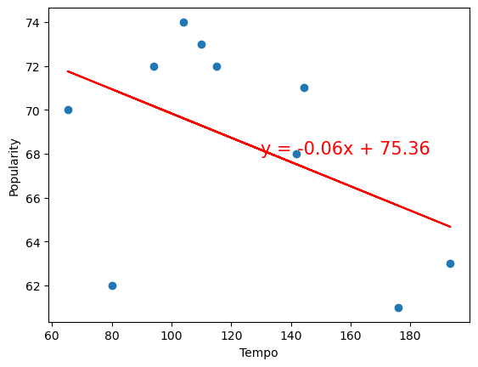
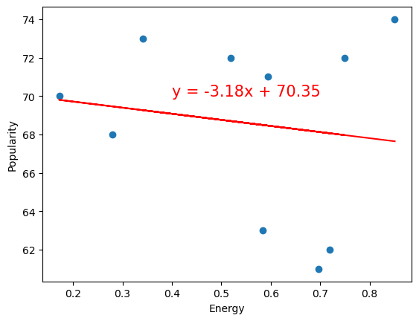
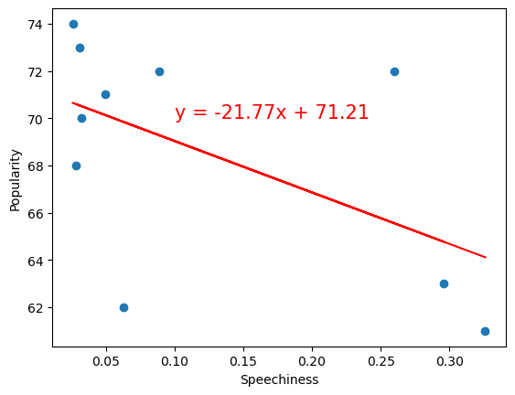
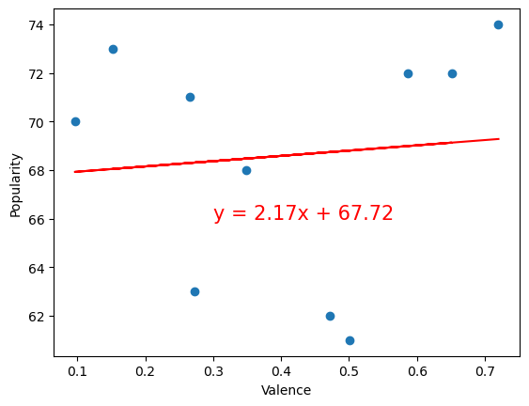
Bottom Tier Analysis
r-value = -0.467
r-value = -0.231
r-value = 0.085
r-value = -0.145
r-value = -0.549
r-value = 0.094
Notes:
There is a medium-strength negative correlation (r = -0.549) between speechiness and popularity, meaning that songs with higher speechiness tend to be lower in popularity in the bottom tier of songs sampled

Slide 25
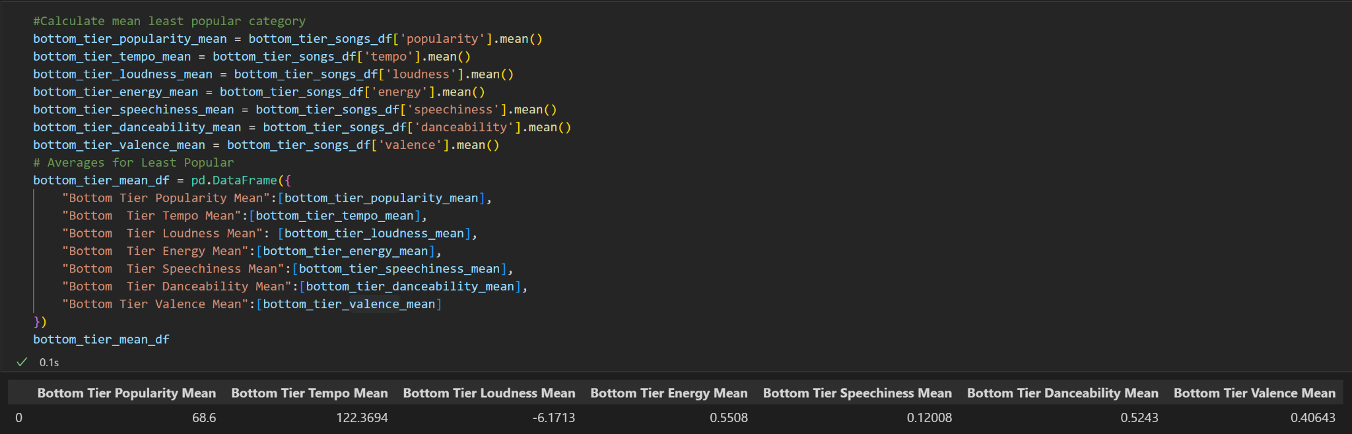
Bottom Tier Songs - Track Attribute Means

Slide 26
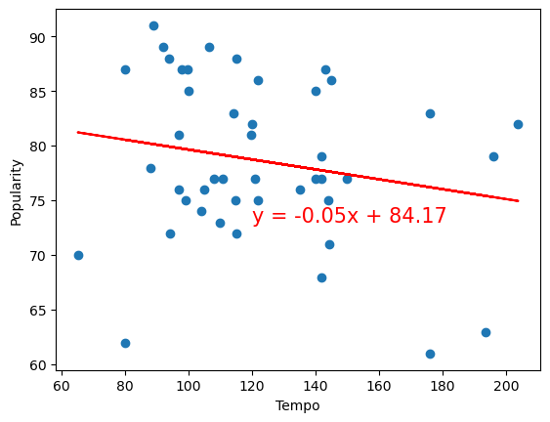
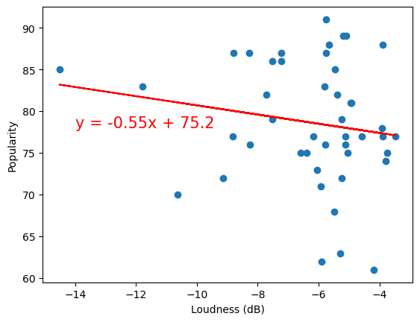
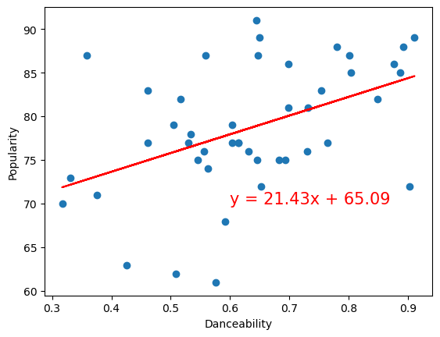
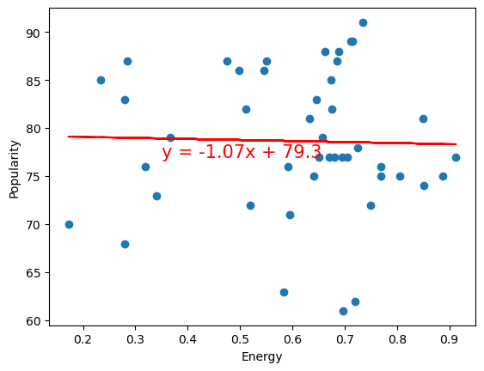
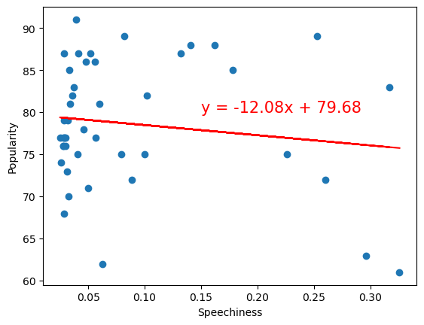
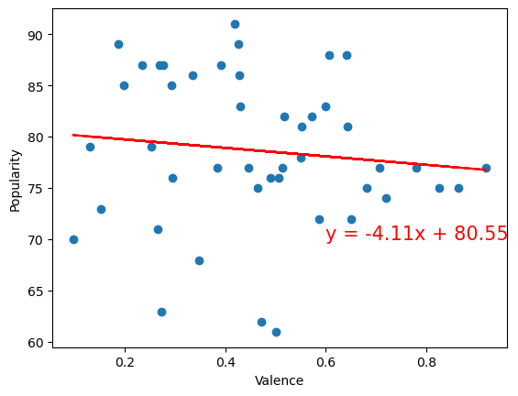
Scatter Plots for the Entire Dataset
r-value: -0.194
r-value: -0.165
r-value: 0.451
r-value: -0.026
r-value: -0.141
r-value: -0.113
Notes:
Danceability has the highest correlation to popularity vs any of the other audio features, when looking at the entire dataset.

Slide 27
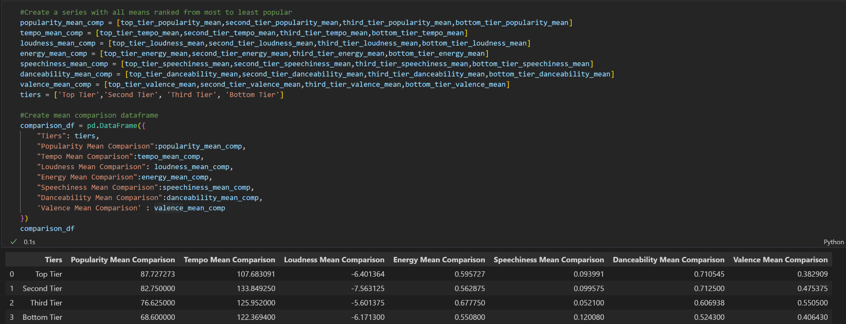
Song Attribute Mean Dataframe - By Tier

Slide 28
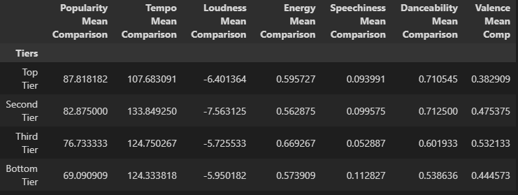
Making Comparisons
Found the mean values of the various audio features for each tier and placed into a dataframe.

Slide 29
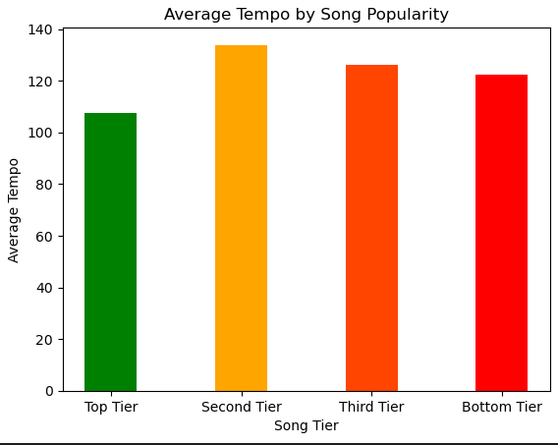





Comparison Analysis
Notes:
Circling back to our first question, are there certain characteristics that make a song more popular?
Seems to be a sweet spot for both tempo and speechiness. Based on our songs, once you get out of that 100bpm tempo, popularity declines. Same thing with speechiness, top and second tiers are right in that 0.09 mark. While as the the third tier had much less speechiness and were more instrumental and the bottom tiers had more speechiness.
Danceability seems to be a good indicator of a song’s popularity. Again top and second tiers are right around the same mark and as danceability goes down so does popularity in the other tiers.
Valence and Energy show some promise. Some differences between tiers but not as stark as in speechiness or danceability.
Loudness has no large differences between the top and bottom tiers

Slide 30

Binning by Popularity
Binning the artists by defined popularity to see popularity of each artist in the charts.
Notes:
Bad Bunny is featured on songs credited to Arcangel, J Balvin, and Nengo Flow
SZA is featured on songs credited to Kendrick Lamar and Doja Cat

Slide 31

Binning by Popularity
Visualization of binned dataframe by Heatmap to see popularity of each artist in the charts
Higher
Correlation
Brighter Color ➔ More correlation:
Adele and Morgan Wallen are more popular than Beyonce on the charts

Slide 32


Correlation between each Audio feature
R = 0.74
Using Seaborn Library, the correlation between each feature could be easily visualized
Found the highest correlation
➔ Energy & Loudness (R = 0.74) are the most correlated features

Slide 33

Correlation between popularity and features
R = -0.21
R = -0.13
R = 0.38
R = -0.19
R = -0.21
R = 0.38
Using Seaborn Library, the correlation between each feature could be easily visualized
What feature is most correlated with Popularity?
➔ Songs with high danceability (R = 0.38) tend to be more popular

Slide 34
Discussion/Final Thoughts
Limitations:
We looked at a limited number of artists
We only looked at the top 9 songs from those artists
We only looked at a limited number of genres
These results may be different based on the genre (i.e. grunge music might have low valence and high popularity?)
‘Popularity’, as defined by spotify, has a time component to it - it’s a mixture of the total number of plays and how recently those plays occurred. This skews ‘popularity’ towards newer music, while older songs could have a disadvantage if they are no longer being played as much as they once were at their peak.
We could take a look at the same song datasets and sort them by raw number of plays to get a clearer perspective of a songs “true” popularity. Comparing spotify’s ‘popularity’ measurement to it’s raw number of plays could be enlightening and provide a baseline to help contextualize the song’s popularity
Future Work:
Looking at data from different markets and making comparisons between countries.
Analyzing larger set of data (more artists, more charts, etc…)
We have to manually input an artist’s URI into the initial code in order to pull their song data. If we created a list of artist URIs and cycled through them programmatically, we could analyze a larger dataset without as much manual labor (aka typing)
Look at chart data .CSV’s and do analysis on popularity trends over time
Notes:
Future Work (1): Different countries will most likely have different top artists. Top tracks per artists could be different.

